Slide 1
Analysing Algorithmic Patterns Based on Real Coding Interview Questions
By Ian Dempsey

Slide 2
Introduction
Motivation
Interviews are becoming more technical.
Discover a relationship between algorithms and questions.
Project Goals
Identify patterns related to standard algorithms.
Apply these patterns to interview questions.
Provide a guidance for programmers to better their abilities.

Slide 3

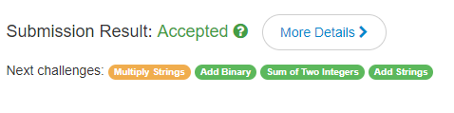
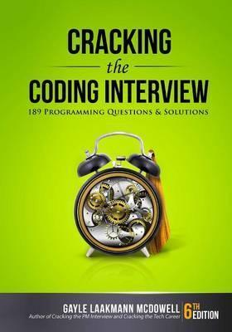
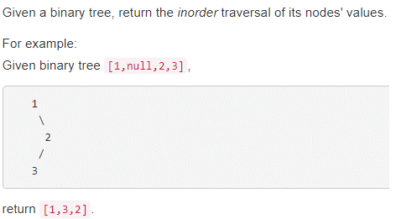
Background
Online repositories.
Active user base.
Online judge system.
Java.
Cracking the Coding Interview.

Slide 4
The Problem
First bullet point here
Second bullet point here
Third bullet point here

Slide 5
The Solution
Step 1 Title
Task description
Step 2 Title
Task description
Step 3 Title
Task description

Slide 6
Evaluation & Conclusion
Class | Group 1 | Group 2
Class 1 | 82 | 95
Class 2 | 76 | 88
Class 3 | 84 | 90

